Slide 1
Corrective Action Response Guidelines For TCEQ Accredited Laboratories
J. Steven Gibson, Ph.D.
Senior Technical Auditor
Laboratory Accreditation Work Group
Texas Commission on Environmental Quality (TCEQ)

Slide 2
Corrective Action Response Process
Based on the increase in repeat deficiencies from laboratories, the TCEQ’s Laboratory Accreditation Program review process for evaluating laboratories’ corrective action responses (CARs) to accreditation assessments was revised.
In December 2015, the revised review process was implemented by the TCEQ in an attempt to lessen future repeat deficiencies from laboratories.
Sixty-four (64) out of seventy (70) laboratories have been issued non-concurrence letters based on unacceptable initial corrective action responses.

Slide 3
Corrective Action
Corrective action as defined by the TCEQ’s Laboratory Accreditation Procedure (LAP) 1.1:
“An action taken to address the effect(s) of a nonconformity, defect, or other undesirable situation (e.g., repair, rework); eliminate the causes of the nonconformity, defect, or other undesirable situation; and prevent recurrence.”

Slide 4
Corrective Action Response Guidelines
Before effectively addressing any finding, you must first understand what the finding is and correctly identify the root cause.
Corrective action(s) must address the issue in all areas of the laboratory and for all applicable staff.

Slide 5
Corrective Action Response Form
The TCEQ has revised the corrective action response form, which is attached to assessment reports.
The form has four main sections:
Corrective Actions to Address the Deficiency
Actions to Prevent Recurrence of the Deficiency
Client Notification
Verification of Effectiveness
For each section, the laboratory must provide the action(s), the timetable(s), and the means to document.

Slide 6
Corrective Action Response Guidelines
Use of the form is not mandatory.
All the information requested on the form is needed to evaluate the laboratory’s corrective action response regardless of the format.

Slide 7
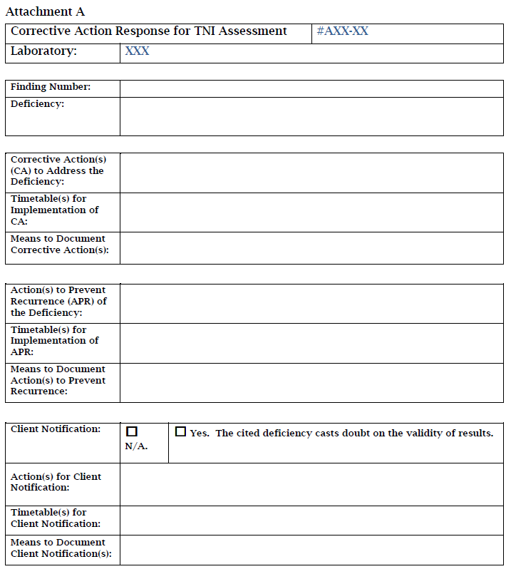
Corrective Action Response Form

Slide 8
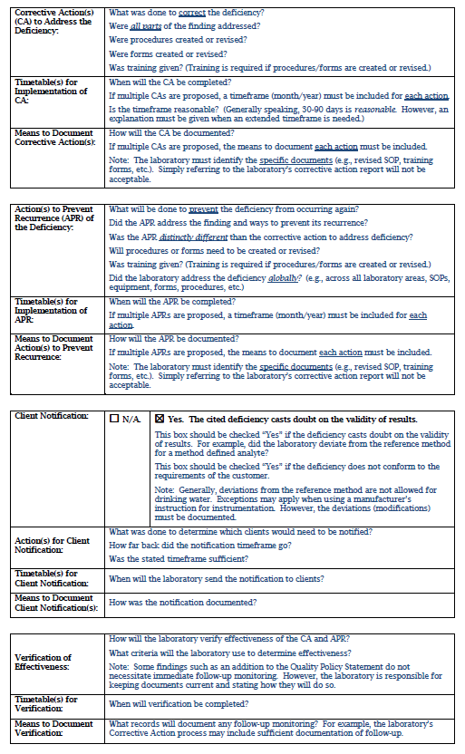
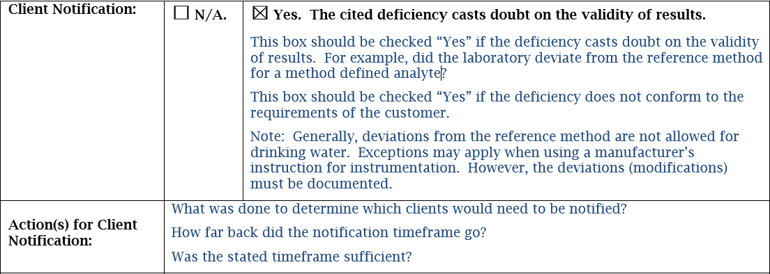
Guidance for Corrective Action Response Form

Slide 9
Guidance for Corrective Action Response Form

Slide 10
Guidance for Corrective Action Response Form

Slide 11
Guidance for Corrective Action Response Form

Slide 12
Guidance for Corrective Action Response Form

Slide 13
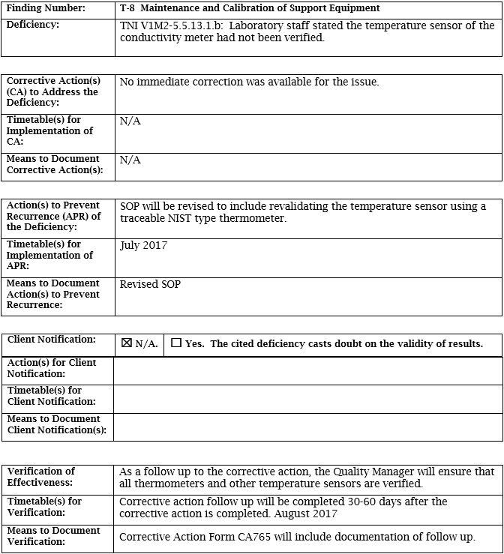
An unacceptable response that would result in a non-concurrence letter
Example 1
Corrective action did not state the sensor in the conductivity meter had been verified at temperatures bracketing the range of use and when the validation occurred.

Slide 14
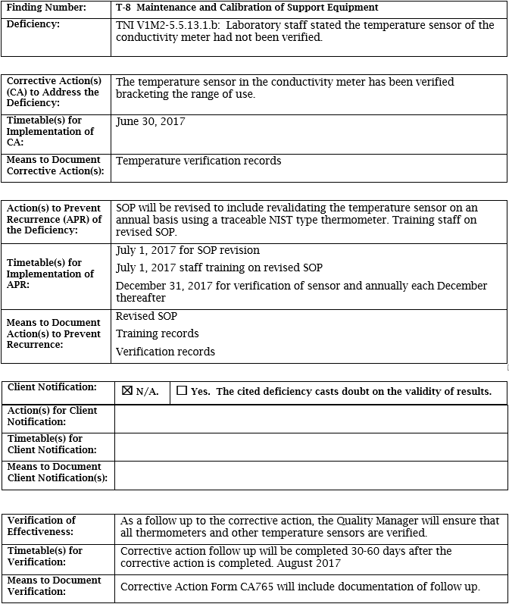
An acceptable corrective action response
Example 1

Slide 15
An unacceptable response that would result in a non-concurrence letter
Example 1
Actions to prevent recurrence also did not include the frequency for validating the sensor or training staff on the revised SOP.
The timetable for training staff on the SOP is not specified.
The means to document action(s) did not include:
records showing the verification of the temperature sensor bracketing the range of use, and
(2) training records.

Slide 16
An acceptable corrective action response
Example 1
Example 1

Slide 17
An acceptable corrective action response
Example 1

Slide 18
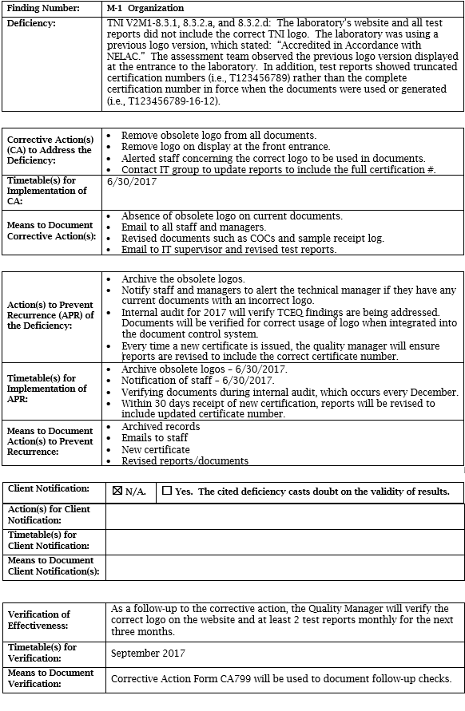
An unacceptable response that would result in a non-concurrence letter
Example 2
The response did not address the laboratory’s website.

Slide 19
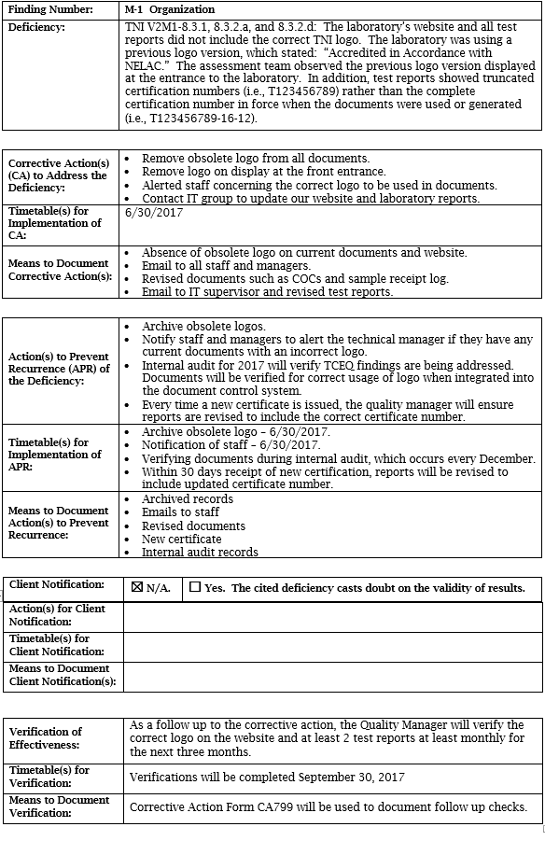
An acceptable corrective action response
Example 2

Slide 20
An unacceptable response that would result in a non-concurrence letter
Example 2
Means to document did not include internal audit records as stated in the action to prevent recurrence.

Slide 21
An acceptable corrective action response
Example 2

Slide 22
An acceptable corrective action response
Example 2

Slide 23
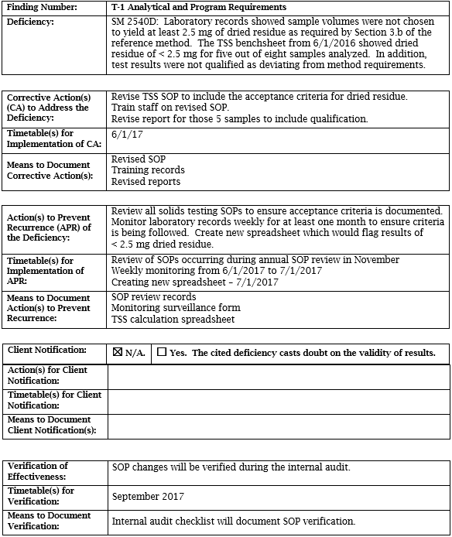
Example 3
An unacceptable response that would result in a non-concurrence letter

Slide 24
Example 3
An unacceptable response that would result in a non-concurrence letter

Slide 25
Example 3
Client results were affected by laboratory practice not following method, thus requiring client notification.
An unacceptable response that would result in a non-concurrence letter

Slide 26
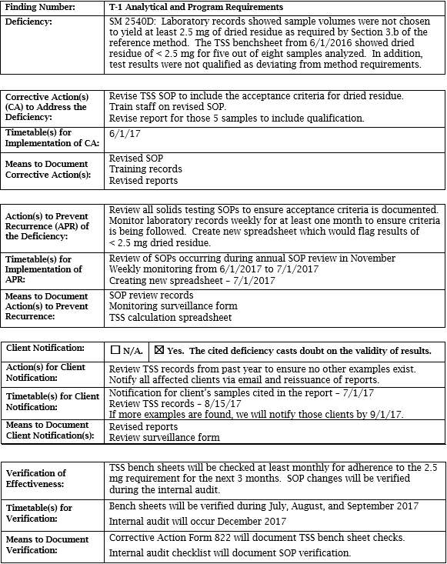
An acceptable corrective action response
Example 3

Slide 27
Example 3
Verification needs to include the implementation of SOP changes into practice, as well as other actions such as bench sheet review.
An unacceptable response that would result in a non-concurrence letter

Slide 28
An acceptable corrective action response
Example 3

Slide 29
In Summary
Each Corrective Action Response must include:
Corrective Action(s) to Address the Deficiency
Action(s) to Prevent Recurrence of the Deficiency
Client Notification
Verification of Effectiveness

Slide 30
For more information:
TCEQ Laboratory Accreditation website
https://www.tceq.texas.gov/agency/qa/env_lab_accreditation.html
The website includes:
Revised Corrective Action Form
TCEQ Guidance on Corrective Action Review
Frequently Asked Questions

Slide 31
Questions?
Dr. J. Steven Gibson
Laboratory Accreditation Work Group
Steve.Gibson@tceq.texas.gov

