Slide 1
Plastics
Plastic generated at organic chemical manufacturing facilities, packaged and transported to processors for molding into plastic products.
Preproduction plastic resin (pellets, powder, and flakes) and not post-consumer refuse such as plastic bottles, straws, or bags.

Slide 2
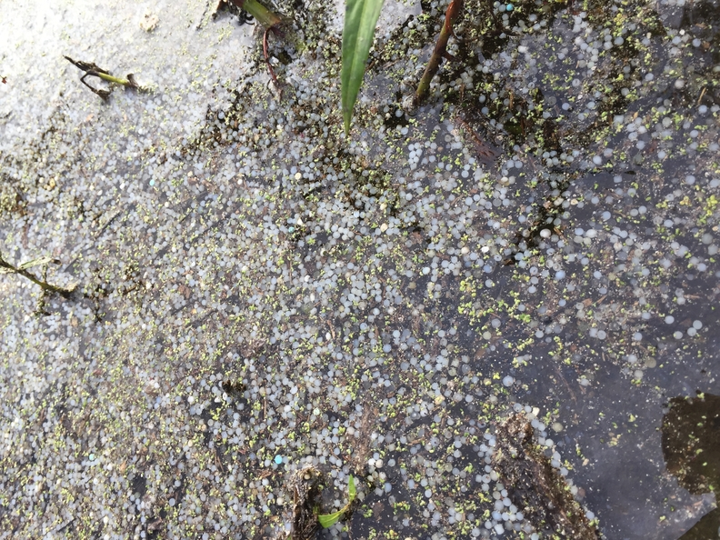
Water Quality Impacts
Physical impacts to aquatic species –
abrasive injuries,
clogging gills and respiratory passages, and
obstructing the digestive system
Impacts to aquatic habitat and ecosystems-
Suspended plastics increase the turbidity of the water, reduce light penetration, and impair the photosynthetic activity of aquatic plants
Settleable plastics degrade benthic organism habitat
Plastic pollution reduces the recreational use and aesthetic value

Slide 3
Plastics Prohibition
There are approximately 155 plastic pellet manufacturers and molders/formers with individual TPDES permits
TPDES permits do not authorize any amount of plastic pellets to be discharged into receiving waters
TCEQ Actions To Clarify Prohibition:
update the Industrial Wastewater Permit Application (TCEQ-10055);
update 30 TAC Chapter 307 to explicitly prohibit the discharge of plastics; and
update individual permits and the Multi-Sector General Permit to clarify prohibition of the discharge of plastics and require BMPs
Investigator Guidance for consistency across TCEQ Regions

Slide 4
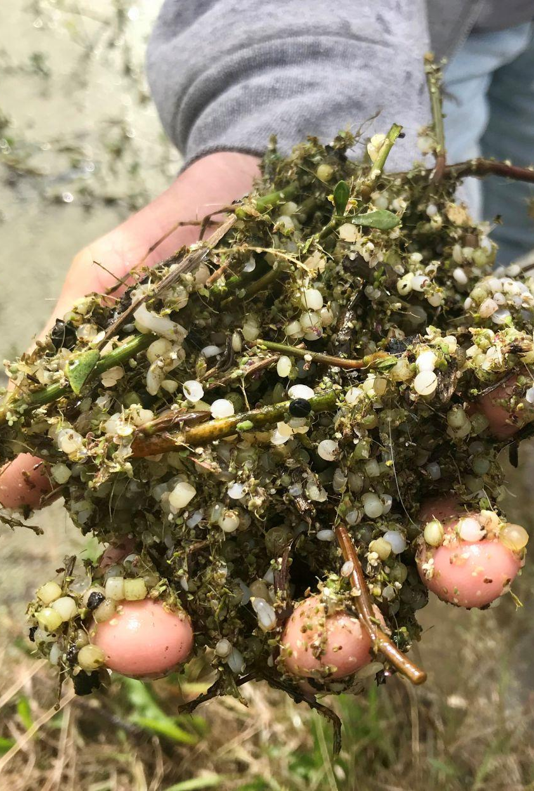
Plastics - Definitions
TCEQ requesting stakeholder input on the appropriate terms and definitions
Example: Plastics means all forms of visible plastic produced, received or handled at the permittee’s facility, including but not limited to: pellets, powder and flakes.
Plastics - Microplastics - Plastic Materials - Preproduction Plastics
Pellets: Polypropylene, PVC, HDPE
Powder, Flakes, Fluff, etc.

Slide 5
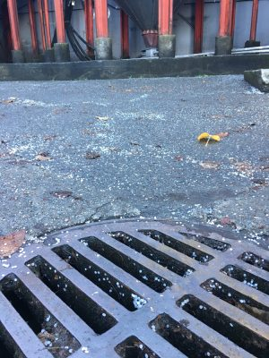
Plastics – Best Management Practices
SWP3 activities implemented to ensure that areas of the facility that can contribute plastic pollutants to stormwater discharges are maintained. Good housekeeping measures must prevent exposure of plastics and other plastic pre-production materials to precipitation or runoff prior to their use in further processing or disposal. Facilities that handle pre-production plastic must implement BMPs to eliminate discharges of plastic in stormwater through the implementation of control measures such as the following, where determined feasible: minimizing spills, cleaning up spills promptly and thoroughly, sweeping thoroughly, and pellet capturing.

Slide 8
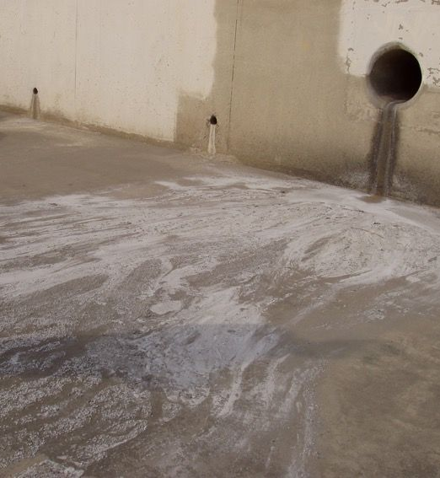
Plastics – Other Requirements
Outfall and receiving water inspection
Notification of spills and unauthorized discharges to Regional Office
Recovery of released materials from receiving waters

Slide 9
Plastics – Other Requirements
Clarification that the point of compliance for the prohibition on the discharge of plastics is the final outfall.
If the discharge enters a water in the State prior to exiting the property, the point of compliance must be located prior to entering a water in the State.
Treatment units such as settling ponds are not considered water in the State.

Slide 10
Plastics – Compliance Period
TCEQ is requesting stakeholder input regarding additional time to comply with a no discharge requirement.
TSWQS allow up to a three-year compliance period.
Request must justify the need for additional time including a construction schedule to install new control structures or retrofitting existing systems to achieve compliance.
If approved, the compliance period will include submission of quarterly progress reports.
TCEQ may reopen permits during the current permit term to include additional requirements under the staff-initiated minor amendment process.

